Slide 1
CONTAINERIZATION & KUBERNETES ON IBM CLOUD
Kiet
Infrastructure Engineer
Quang
DevOps Administrator
8 May 2020

Slide 2
AGENDA
Containerization
Container Orchestration
Kubernetes
Kubernetes on IBM Cloud
Demo
Q&A

Slide 3
AGENDA
Containerization
Container Orchestration
Kubernetes
Kubernetes on IBM Cloud
Demo
Q&A

Slide 4
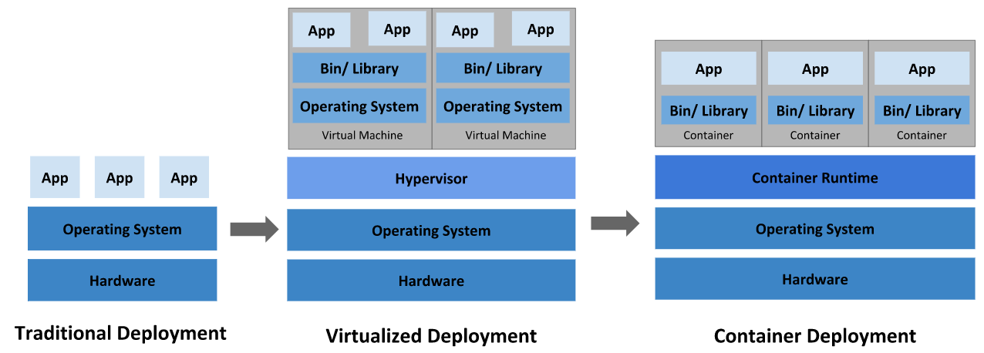
TRADITIONAL

Slide 5
CONTAINERIZATION
* The container shares the kernel of the host OS with other containers, and the shared part of the OS is read-only. Therefore, the containers are lightweight, so you can deploy multiple containers on a single server (or a VM)

Slide 6
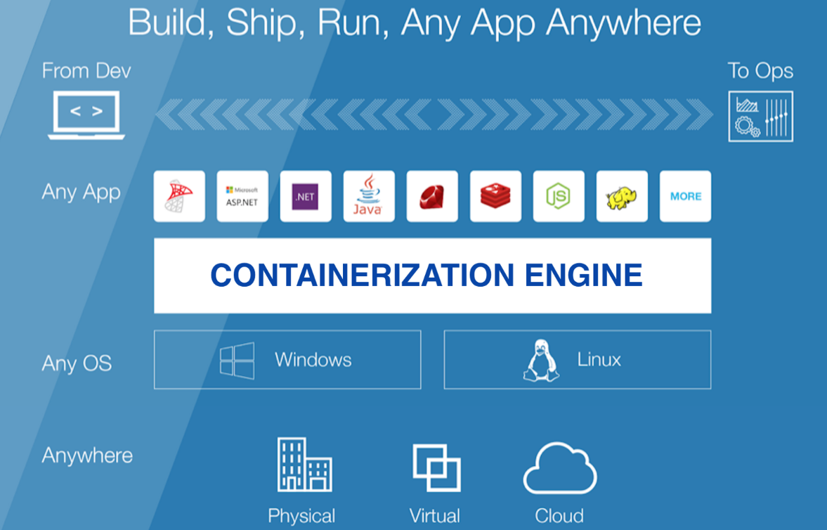
CONTAINERIZATION: PROS & CONS
Advantages:
Lightweight, less resource usage
Speed: Reduce the time needed to deploy and run an application
Resources: Low Overhead, Save Disk…
Portability and application sharing easier.
Consistent Environment: software dependencies, specific versions of programming language runtimes and other software libraries.
….
Disadvantages :
Containers based on a different OS will require a different host.
Security and isolation: vulnerability in the OS kernel is a threat to all containers on the host machine
Containerization is still a new solution
….

Slide 7

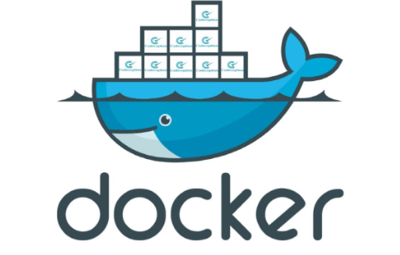
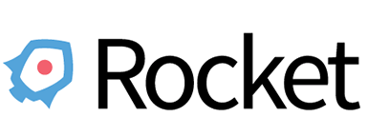
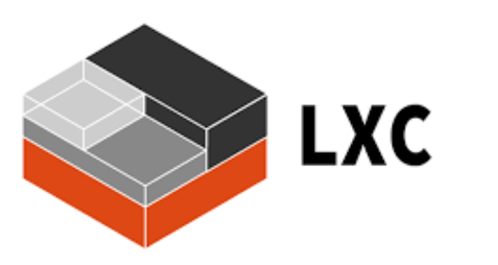

CONTAINER RUNTIMES

Slide 8
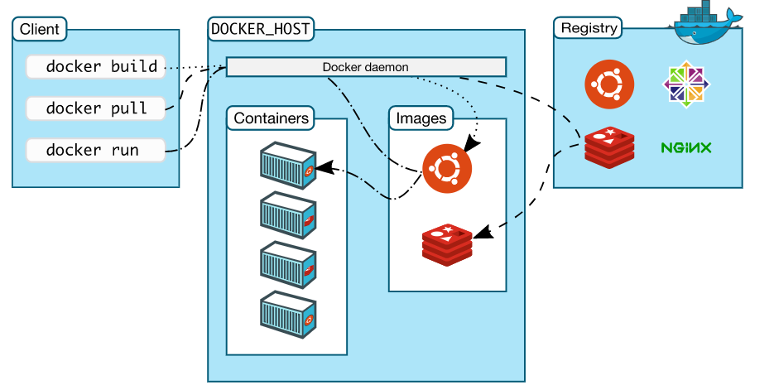
DOCKER - COMPONENTS
Keywords:
Images: read-only template with instructions for creating a Docker container
Containers: runnable instance of an image
Docker Registry: stores Docker images
Docker Daemon: manages Docker objects
Docker Client: users interact with Docker
Docker Hosts: Nodes & Cluster

Slide 9
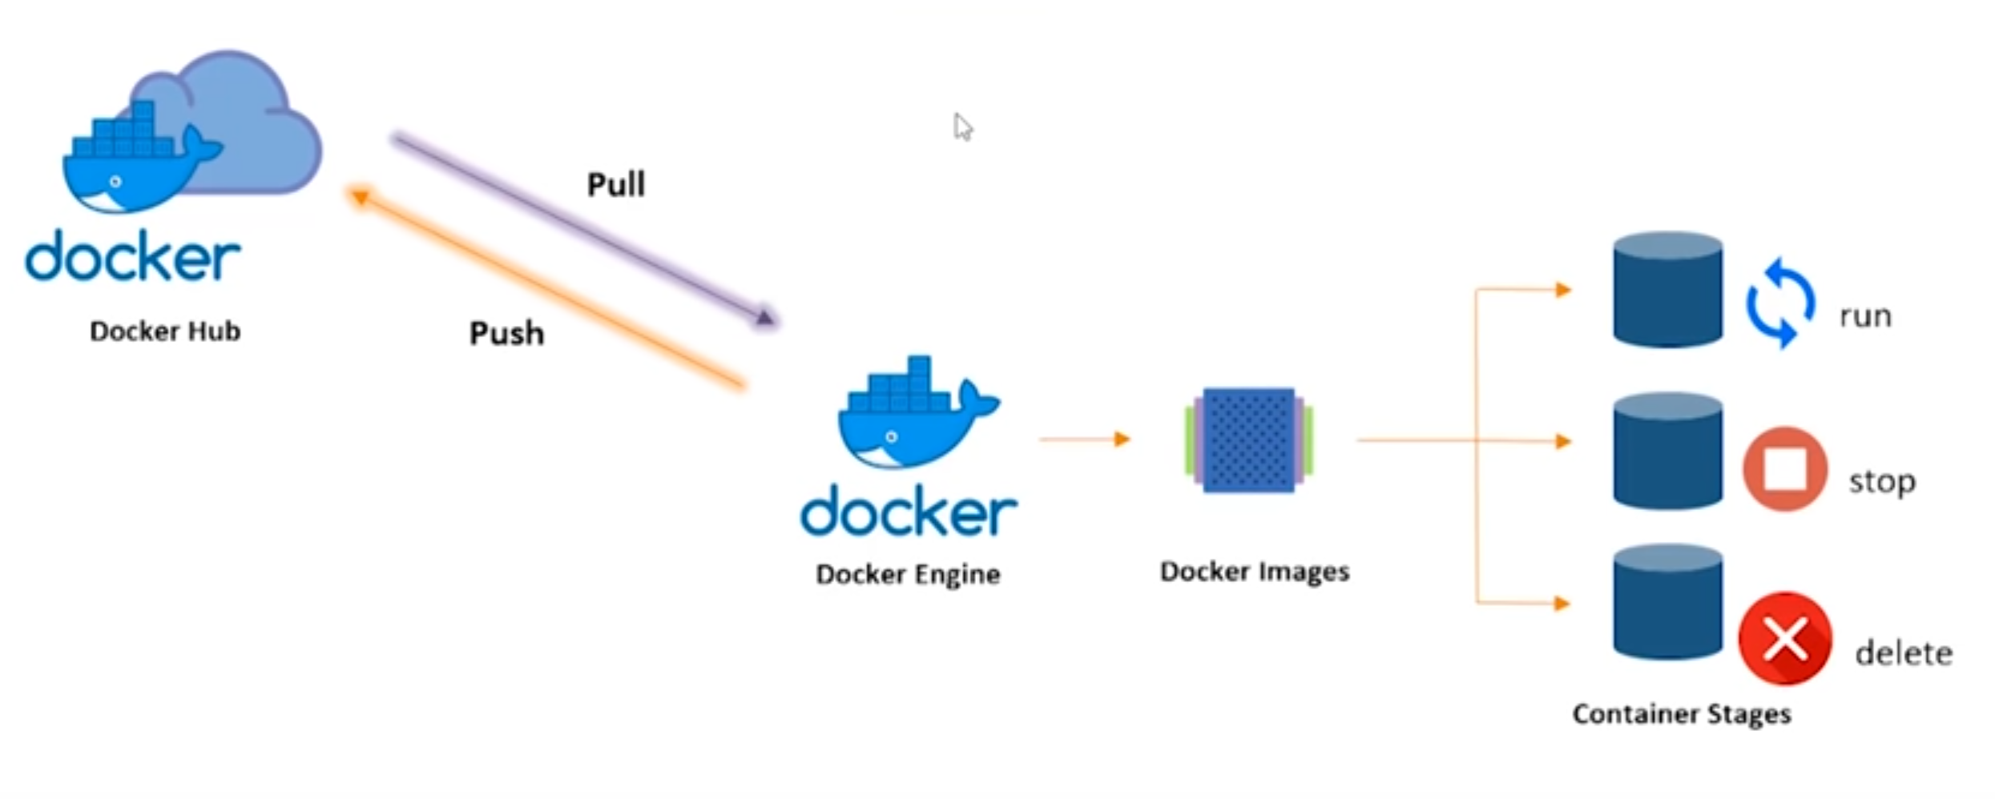
DOCKER – SIMPLE FLOW / LIFECYCLE

Slide 10
Containerization
Container Orchestration
Kubernetes
Kubernetes on IBM Cloud
Demo
Q&A

Slide 11
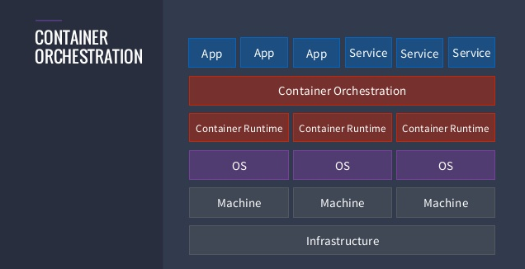
ORCHESTRATORS

Slide 12
ORCHESTRATORS
Definition from Docker: Tools to manage, scale, and maintain containerized applications are called orchestrators
Why Do We need Container Orchestration?
Configuring and scheduling of containers
Provisioning and deployments of containers
Availability of containers
The configuration of applications in terms of the containers that they run in
Scaling of containers to equally balance application workloads across infrastructure
Allocation of resources between containers
Load balancing, traffic routing and service discovery of containers
Health monitoring of containers
Securing the interactions between containers.

Slide 13
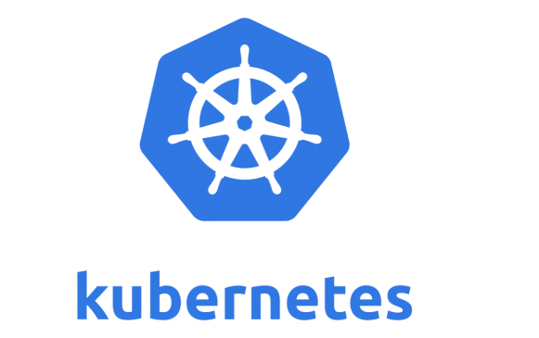
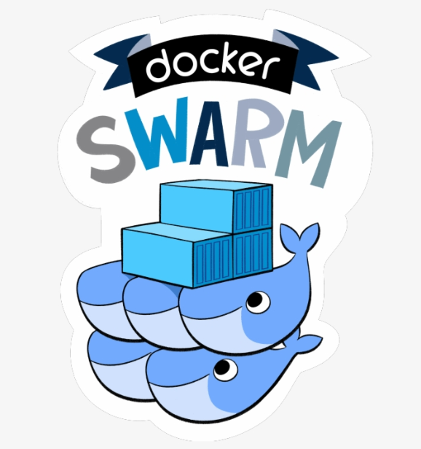

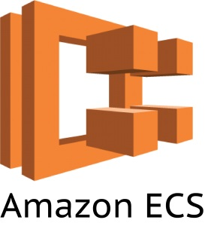
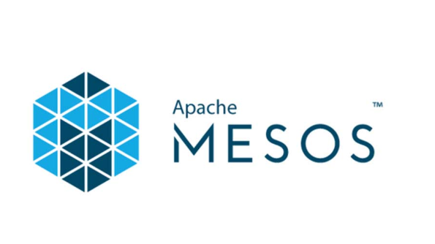
CONTAINER ORCHESTRATION TOOLS

Slide 14
Containerization
Container Orchestration
Kubernetes
Kubernetes on IBM Cloud
Demo
Q&A

Slide 15
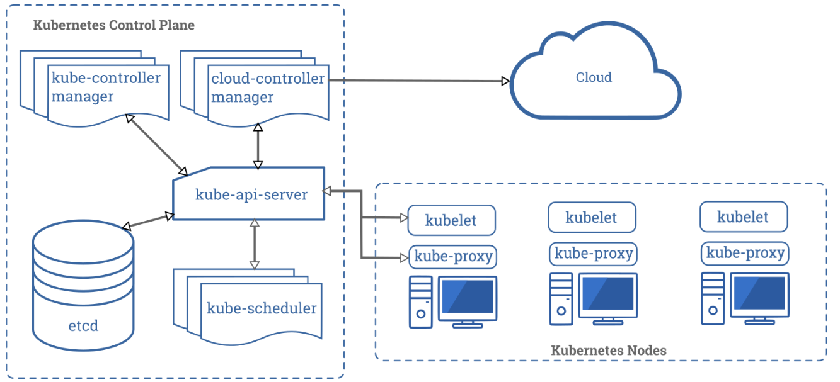
KUBERNETES - COMPONENTS
Kubernetes Cluster:
Control Plane (Master)
Nodes (Worker Nodes)
Container Runtime*
* Kubernetes supports several container runtimes: Docker, containerd, CRI-O, and any implementation of the Kubernetes CRI (Container Runtime Interface).

Slide 16
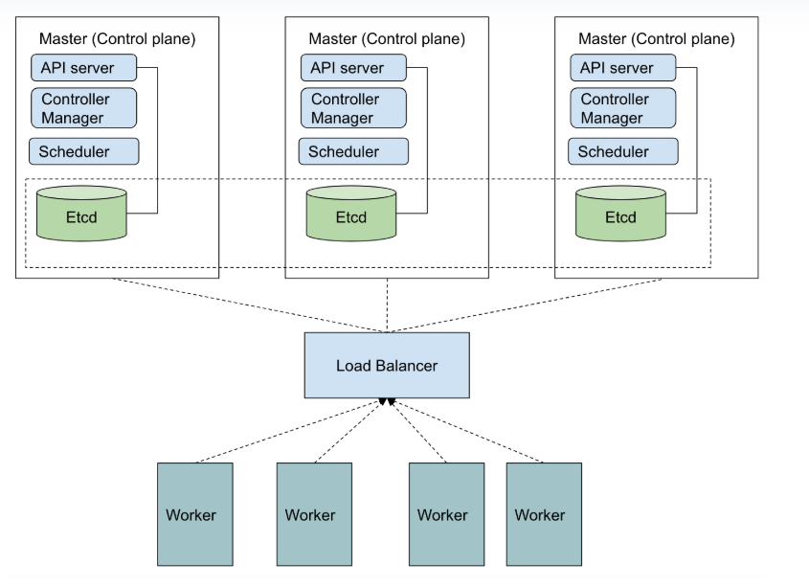
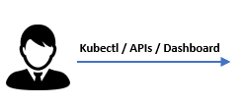
KUBERNETES – EXAMPLE ARCHITECTURE

Slide 17
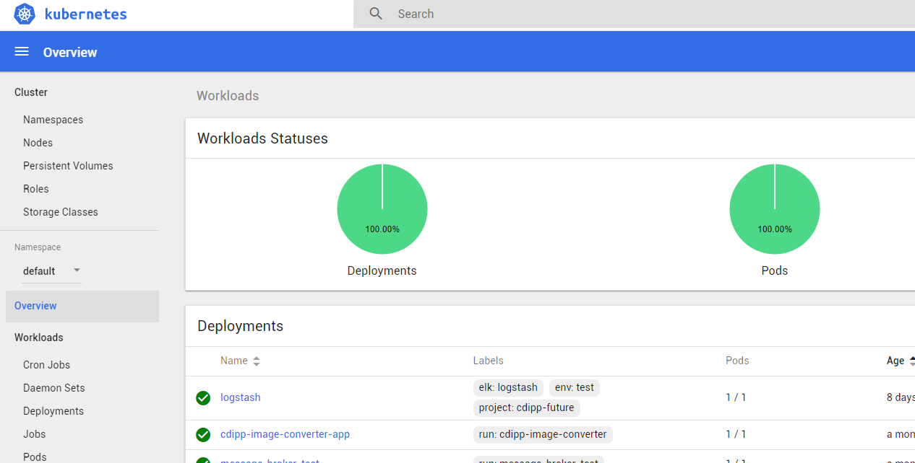
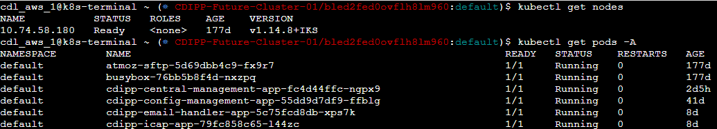
KUBERNETES - ACCESSING CLUSTERS
kubectl (Command Line)
Web UI (Dashboard)
API
….

Slide 18
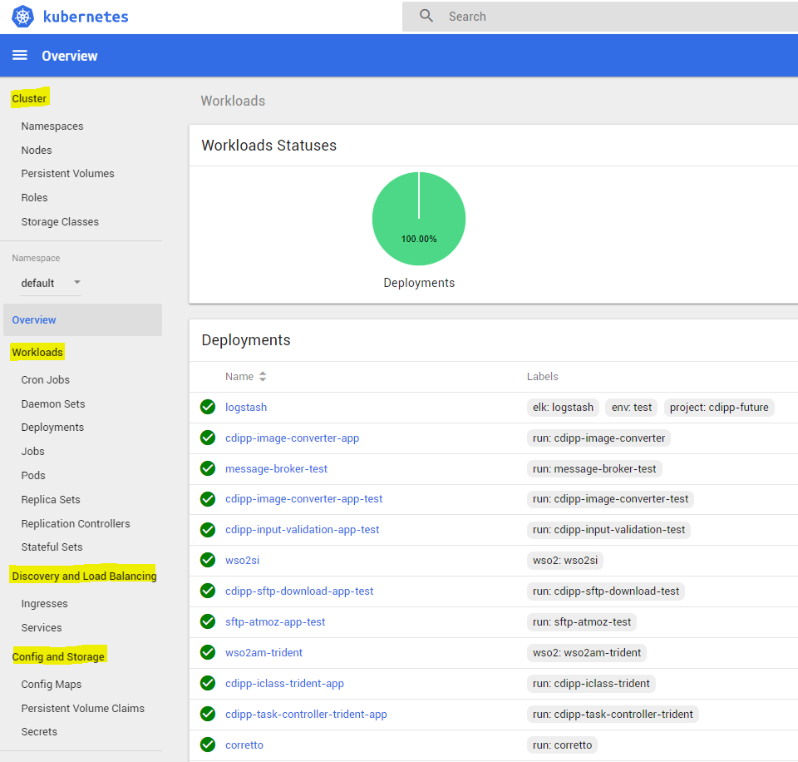
KUBERNETES - OBJECTS
Kubernetes objects are persistent entities in the Kubernetes system. Kubernetes uses these entities to represent the state of your cluster.
The objects are categorized as:
Cluster: Managing cluster state and configurations
Namespaces
Persistent Volumes (PV)
Workloads: Manage containers and their lifetimes
Daemon Sets
Deployments
Pods
Discovery & Load Balancing: Make your applications accessible to each other or external world
Services
Config & Storage: Bind data to your containers
Persistent Volume Claims (PVC)
Metadata: Adjust the behavioral data for other objects

Slide 19
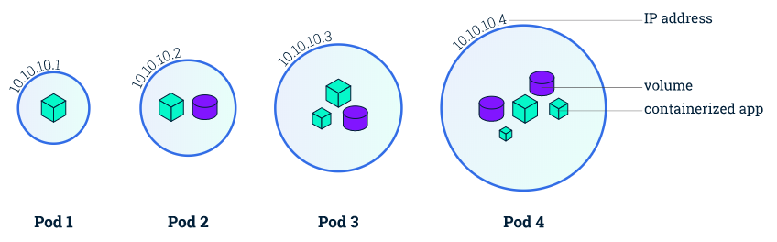
KUBERNETES – PODS / CONTAINERS
A Pod is a Kubernetes abstraction that represents a group of one or more application containers (such as Docker or rkt), and some shared resources for those containers. Those resources include:
Shared storage, as Volumes
Networking, as a unique cluster IP address
Information about how to run each container, such as the container image version or specific ports to use

Slide 20
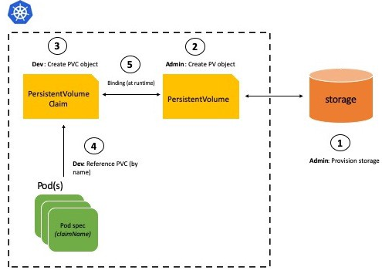
KUBERNETES – PV AND PVC

Slide 21
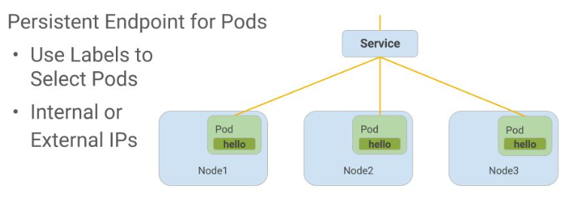
KUBERNETES – SERVICES
An abstract way to expose an application running on a set of Pods as a network service.
ClusterIP (default) - Exposes the Service on an internal IP in the cluster. This type makes the Service only reachable from within the cluster.
NodePort - Exposes the Service on the same port of each selected Node in the cluster using NAT. Makes a Service accessible from outside the cluster using <NodeIP>:<NodePort>. Superset of ClusterIP.
LoadBalancer - Creates an external load balancer in the current cloud (if supported) and assigns a fixed, external IP to the Service. Superset of NodePort.
ExternalName - Exposes the Service using an arbitrary name (specified by externalName in the spec) by returning a CNAME record with the name. No proxy is used. This type requires v1.7 or higher of kube-dns.

Slide 22
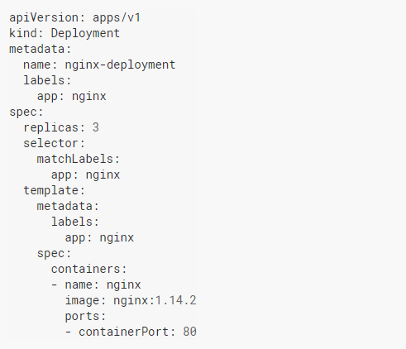
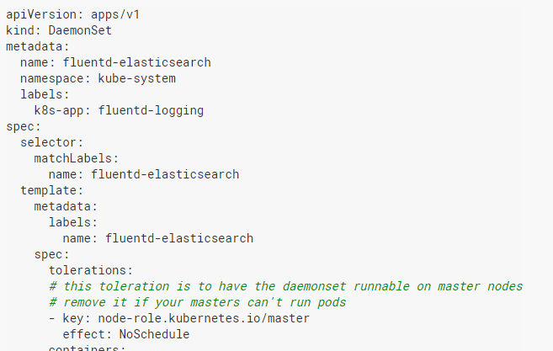
KUBERNETES – CONTROLLERS
Deployments: an object in Kubernetes that lets you manage a set of identical pods (Without a deployment, we have to create, update, and delete a bunch of pods manually)
DaemonSet: A DaemonSet ensures that all (or some) Nodes run a copy of a Pod. As nodes are added to the cluster, Pods are added to them. As nodes are removed from the cluster, those Pods are garbage collected.
Other Controllers: ReplicaSet /ReplicationController / StatefulSets / Garbage Collection / Job & CronJob

Slide 23
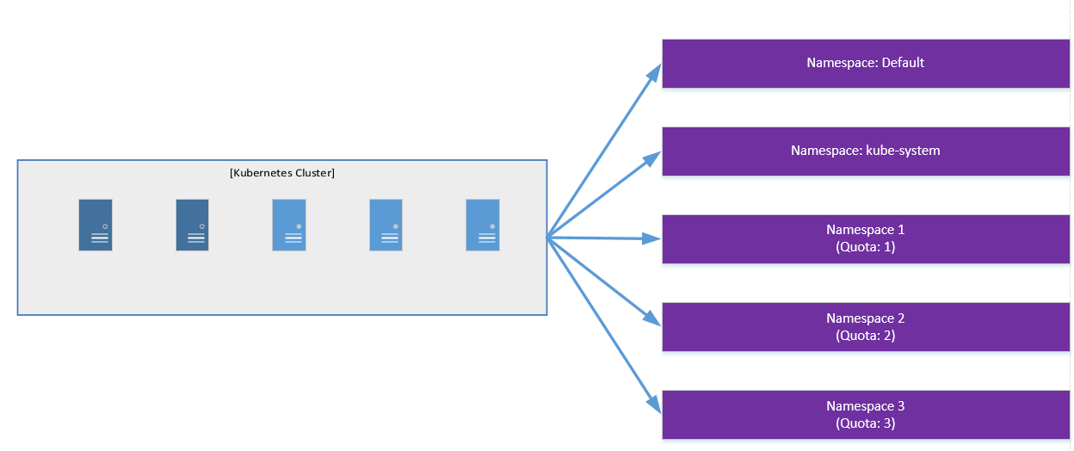
KUBERNETES – NAMESPACES

Slide 24
KUBERNETES – DISTRIBUTIONS
Software Distributions (Locally or Cloud hosted):
CoreOS
Pivotal Container Service (PKS)
Rancher
Red Hat OpenShift
SUSE Container as a Service Platform (CaaS)
…
Dedicated Cloud Services:
Amazon Elastic Container Service for Kubernetes (Amazon EKS)
Azure Kubernetes Service (AKS)
Google Kubernetes Engine (GKE)
IBM Cloud Kubernetes Service
…

Slide 25
Containerization
Container Orchestration
Kubernetes
Kubernetes on IBM Cloud
Demo
Q&A

Slide 26
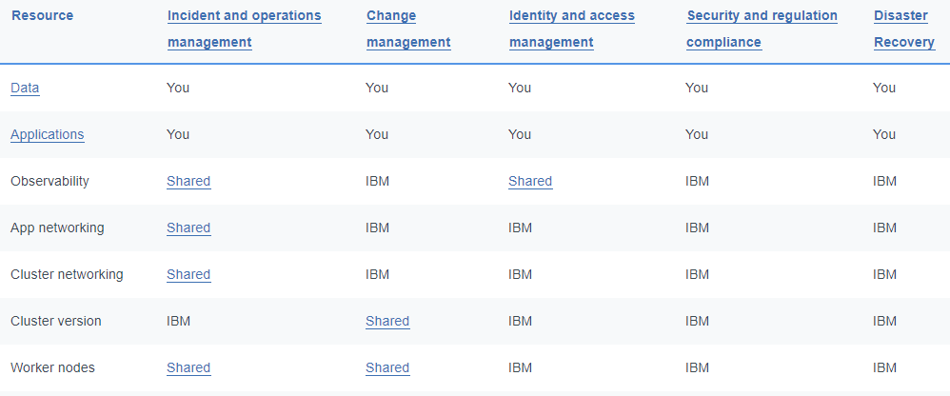
IBM CLOUD KUBERNETES SERVICE
Shared Responsibilities:
Infrastructure Options:
Classic clusters are created on your choice of virtual or bare metal worker nodes that are connected to VLANs.
VPC clusters are created in your own Virtual Private Cloud that gives you the security of a private cloud environment with the dynamic scalability of a public cloud. You use network access control lists to protect the subnets that your worker nodes are connected to.

Slide 27
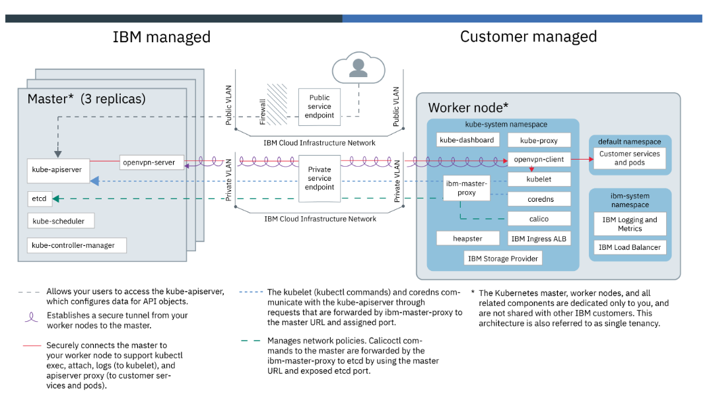
CLASSIC CLUSTER: ARCHITECTURE

Slide 28
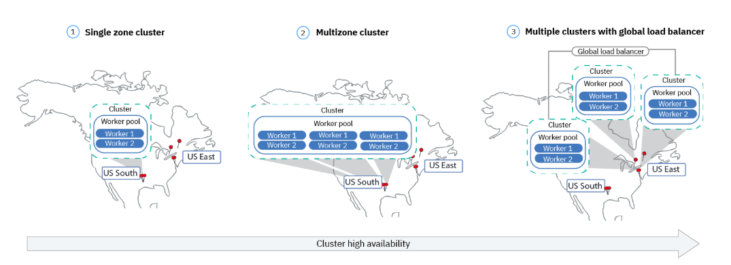
HIGH AVAILABILITY ARCHITECTURE

Slide 29
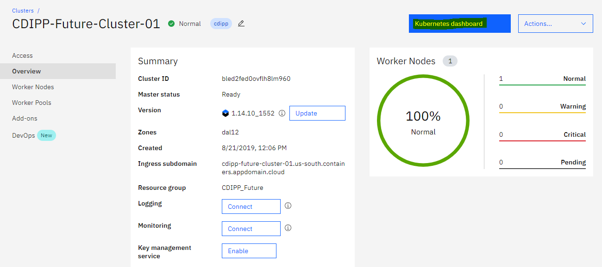
CONTROL PLANE (MASTER)

Slide 30
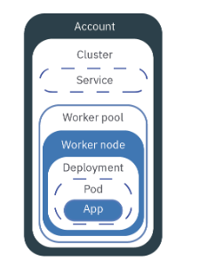
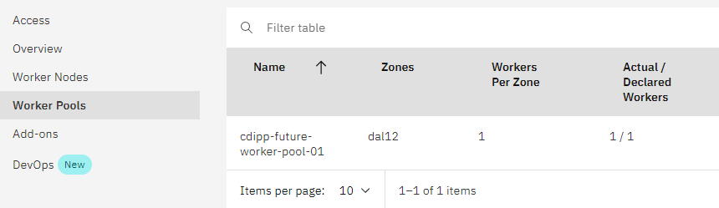
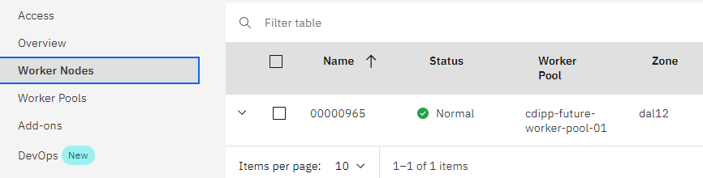
WORKER POOLS / WORKER NODES

Slide 31
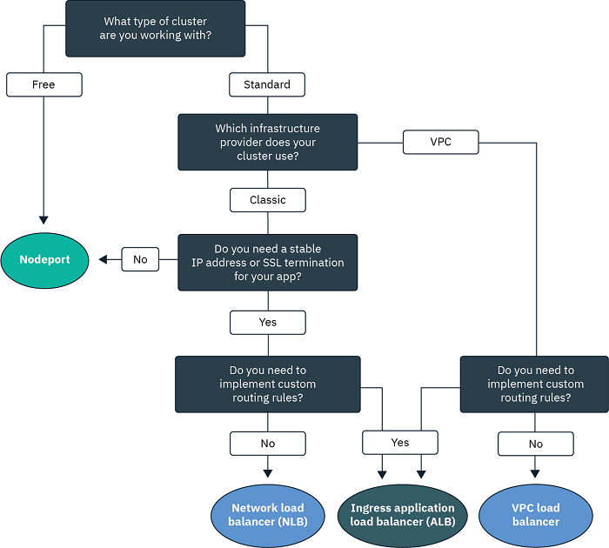
SERVICE EXPOSING

Slide 32
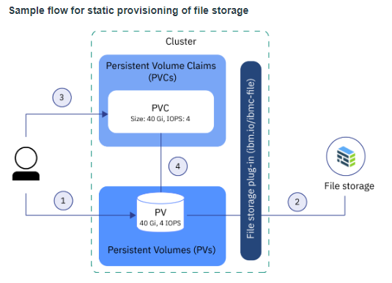
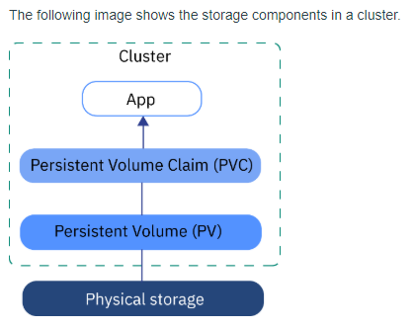
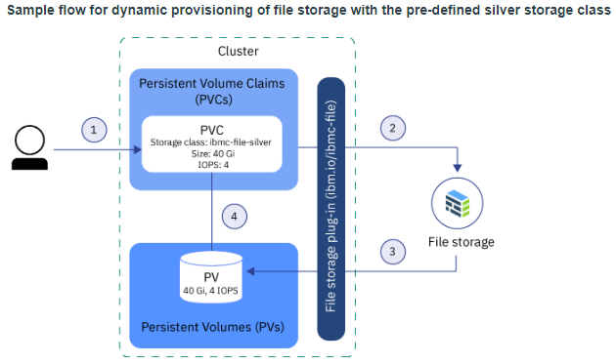
STORAGE – STATIC/DYNAMIC PROVISIONING
Physical storage in IBM Cloud
File Storage
Block Storage
Object Storage,
Local worker node storage that you can use as SDS storage with Portworx.

Slide 33
Containerization
Container Orchestration
Kubernetes
Kubernetes on IBM Cloud
Demo
Q&A

Slide 34
Containerization
Container Orchestration
Kubernetes
Kubernetes on IBM Cloud
Demo
Q&A

Slide 35
RESOURCES
Docker:
https://docs.docker.com/
Kubernetes:
https://kubernetes.io/docs/home/
IBM Cloud Kubernetes Service:
https://cloud.ibm.com/docs/containers?topic=containers-getting-started#container_index

